Slide 1
Quantitative Risk Management: Lecture 1 – Regulatory Regimes, Types of Risk, Important Background Material and Introduction to Value at Risk
Roy E. DeMeo, Jr.

Slide 2
What is Risk Management?
The purpose of risk management to ensure that a financial firm holds enough capital to survive potential losses without risking insolvency. Types of risk include:
Market risk
Counterparty credit risk
Model risk
Operational Risk
We will only cover the first three types of risk in this course.

Slide 3
Types of Risk Measures
General Value at Risk (GVaR)
Stressed Value at Risk (SVaR)
Specific Risk
Stress scenarios
Incremental Risk Charge (IRC)
Standard Charges
Potential Future Exposure (PFE), Expected Exposure (EE)
Credit Valuation Adjustment (CVA)
Wrong-way Risk
Comprehensive Risk Measure (CRM)
Liquidity Risk
Funding Valuation Adjustment (FVA)
Risk not in Model

Slide 4
Regulations and Regulators
Risk management is driven by the rules drafted in Basel, Switzerland, known as Basel I, II, 2.5 and III (and eventually, IV), which determine how much capital a financial firm should hold.
Main regulator is OCC (Office of Controller of the Currency), which issues “Matters Requiring Attention” (MRAs) demanding adherence to high standard of accuracy in the firm’s risk models. The SEC also plays a role.
Banks also employ risk management models to limit losses in each trading desk’s ongoing business.

Slide 5
Basel I Requirements
Bank must hold capital equal to 8 percent of its risk-weighted assets (RWA), where assets fall into 4 categories of credit risk, with weights of 0, 20, 50 and 100 percent.
Capital is divided into three “tiers” (1) equity capital, retained earnings or equivalent, (2) Subordinated debt (>5 Year maturity) and similar sources, and (3) shorter-term subordinated debt.

Slide 6
Basel II Requirements
Bank must hold capital which is a multiple of 10-day Value at Risk.
Bank must add capital to account for “Specific risk”, which includes unusually large or idiosyncratic moves in stocks or bonds, and also includes credit migrations and defaults.

Slide 7
Basel 2.5 Requirements
Specific risk no longer includes migration or defaults but only “idiosyncratic” or large moves.
Bank must compute Stressed Value at Risk (SVaR), which is VaR assuming market conditions of a highly volatility period. Bank must hold capital to cover this in addition to general VaR, or GVaR. Stressed VaR will be defined more precisely later.
Incremental risk charge, aims to capture default and credit migration risk.
Comprehensive risk measure (CRM), for correlation trading positions.

Slide 8
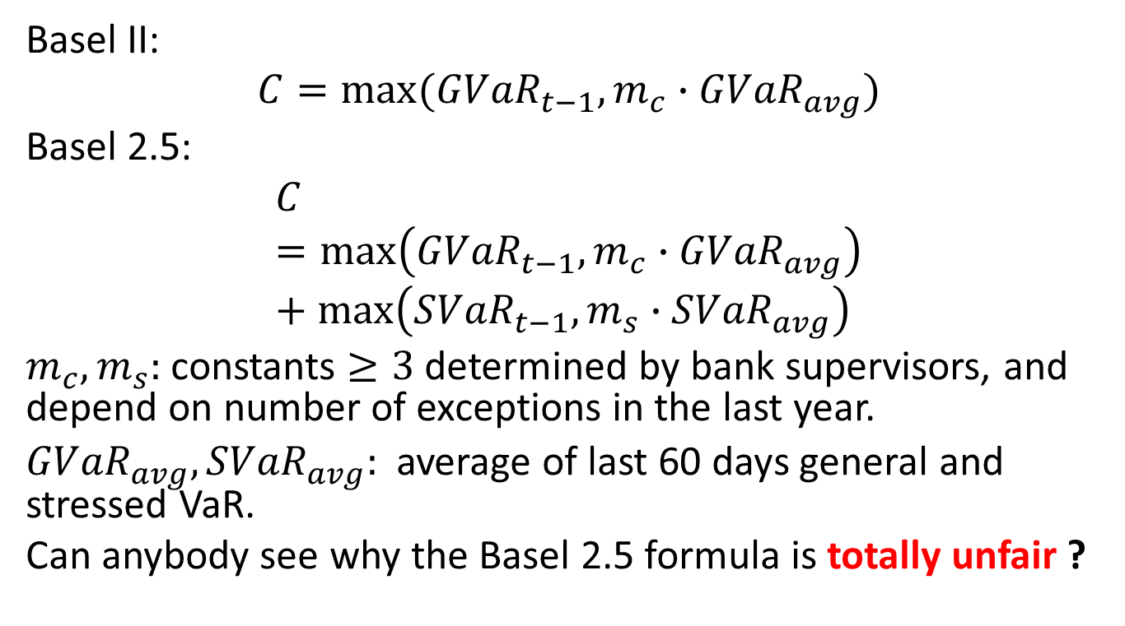
Capital Required for GVaR & SVaR
Basel II:
$$C=max⁡({GVaR}_{t−1},m_{c}∙{GVaR}_{avg})$$
Basel 2.5:
$$C=\max\left({GVaR}_{t−1},m_{c}∙{GVaR}_{avg}\right)+\max\left({SVaR}_{t−1},m_{s}∙{SVaR}_{avg}\right)$$
$m_{c},m_{s}:$constants $≥3$ determined by bank supervisors, and depend on number of exceptions in the last year.
${GVaR}_{avg}, {SVaR}_{avg}:$ average of last 60 days general and stressed VaR.
Can anybody see why the Basel 2.5 formula is totally unfair ?

Slide 9
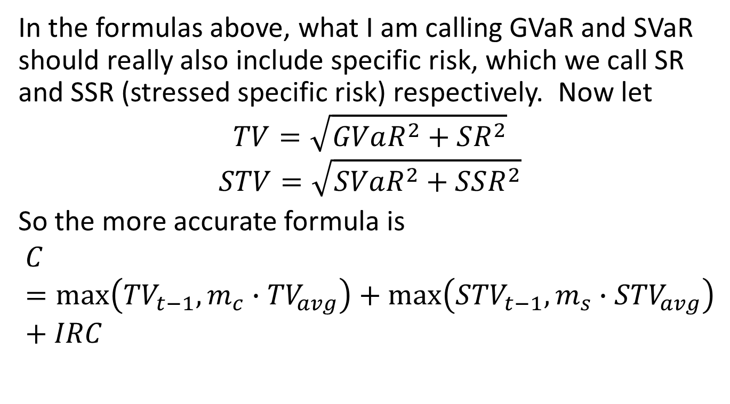
More on Basel 2.5 Capital Requirements
In the formulas above, what I am calling GVaR and SVaR should really also include specific risk, which we call SR and SSR (stressed specific risk) respectively. Now let
$$TV=\sqrt{GVaR^{2}+SR^{2}}$$
$$STV=\sqrt{SVaR^{2}+SSR^{2}}$$
So the more accurate formula is
$$C=\max\left({TV}_{t−1},m_{c}∙{TV}_{avg}\right)+\max\left({STV}_{t−1},m_{s}∙{STV}_{avg}\right)+IRC$$

Slide 10
Basel III Requirements
Bank must add capital to account for credit valuation adjustment (CVA), which adjusts a book’s value based on the risk of counterparty default.
Bank must account for “wrong-way” risk, which is when changes in counterparty exposure are positively correlated with changes in counterparty credit spreads.
Tier 3 Capital no longer counts as capital, and Tier 1 is split up into two sub-categories, (a) common equity and (b) some items such as non-cumulative preferred stock which used to be part of Tier 1.

Slide 11
Basel III Requirements, Cont’d
Tier 1 equity capital must be at least 4.5% of risk-weighted assets (RWA).
Total tier 1 capital (including the additional tier1 capital) must be at least 6% of RWA.
Total tier1 + tier 2 capital must be at least 8% of RWA.

Slide 12
Basel III Limits on Dividends
A bank can pay out the following percentages of retained earnings as dividends based on the Tier 1 equity capital percentage of risk-weighted assets:
4% to 5.125%: 0%
5.125% to 5.75%: 20%
5.75% to 6.375%: 40%
6.375% to 7%: 60%
> 7%: 100%

Slide 13
Basel IV Requirements
Soon we will cover Delta/Gamma approximation for VaR P&L later in this lecture.
But Basel IV will forbid P&L approximations based on Taylor series – will require full revaluation or interpolation off a grid (more details later).
Basel IV will not allow Value at Risk anymore but rather Expected Shortfall, which has certain advantages and we will cover later.
Basel IV will no longer consider Specific Risk, to be covered later.

Slide 14
Why Risk Management is Important, Even Without Basel Rules
Risk Management can reduce average tax bill, because earnings are more even
Risk Management can improve a firm’s access to capital markets.
Risk Management makes bankruptcy less likely, which increases a firm’s value
Risk Management can make external financing less expensive overall.

Slide 15
Main Sources of Risk
A bank computes VaR and other risk measures for a “top-of-the-house” portfolio which may include stocks, currencies, interest rate products, commodities, credit default swaps, bonds (including convertibles), and mortgage products.
Specific Risk covers bonds, CDSs and equity products
Incremental risk charge covers bonds and credit products

Slide 16
Sources of Risk, Continued
Equity products – stock prices, implied volatilities, skews, smiles, discount rates and dividends
FX products – exchange rates, implied volatilities, risk reversals, butterflies, domestic and foreign interest rates
Interest rate products – swap rates, LIBOR rates, swaption implied volatilities, cap/floor implied volatilities, swaption and cap/floor skews

Slide 17
Sources of Risk, Continued
Commodities – futures prices, futures implied volatilities, discount rates, implied volatility skews
Corporate/Agency/Municipal Bonds – Credit spreads, discount rates, rate volatilities (if callable), default and migration risk (for IRC, not VaR)
Credit Default Swaps and CDX trades - Credit spreads, discount rates, rate volatilities (if callable), default and migration risk (for IRC, not VaR)
Mortgage products – interest rates, TBA futures prices, prepayment curves

Slide 18
Hard-to-Model Risks
Equities – correlations among different equities, correlations of stock versus implied volatilities, future skews (for cliquets).
FX – correlations between implied volatilities and spot, jump risk (for pegged currencies)
Commodities – correlations between volatilities and futures prices
Credit products and bonds – correlations among credit spread movements, default clustering, correlations between interest rates and credit spreads, volatilities of credit spreads

Slide 19
What is Value At Risk?
Value at Risk, or VaR, is roughly speaking, a measure of how much money a bank or other financial firm can lose on its positions in a fixed period, such as 1 day, 10 days, or 1 year in a “worst case” (worst 1 percent) scenario.
Losses can be due to diffusive moves (“general” VaR) or defaults or credit migrations (“incremental risk charge”), or so-called “special events” (“specific risk”)

Slide 20
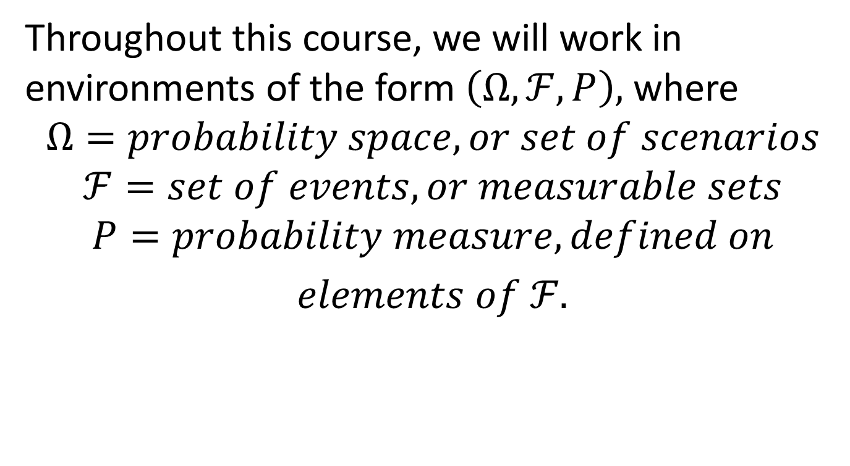
Basic Probability Assumptions
Throughout this course, we will work in environments of the form $\left(Ω,ℱ,P\right),$ where
$$Ω=probability space, or set of scenarios$$
$$ℱ=set of events, or measurable sets$$
$$P=probability measure, defined on$$
$elements of ℱ.$

Slide 21
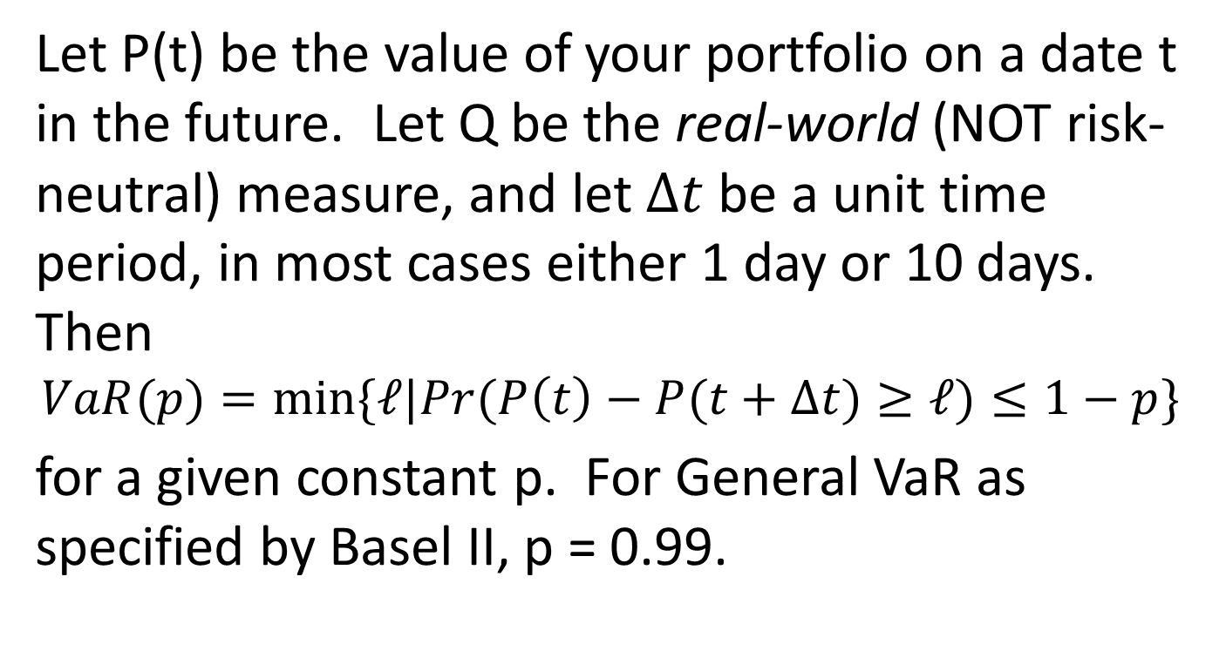
Definition of VaR
Let P(t) be the value of your portfolio on a date t in the future. Let Q be the real-world (NOT risk-neutral) measure, and let $∆t$ be a unit time period, in most cases either 1 day or 10 days. Then
$$VaR(p)=min⁡\{ℓ|Pr(P\left(t\right)−P(t+∆t)≥ℓ)≤1−p\}$$
for a given constant p. For General VaR as specified by Basel II, p = 0.99.

Slide 22
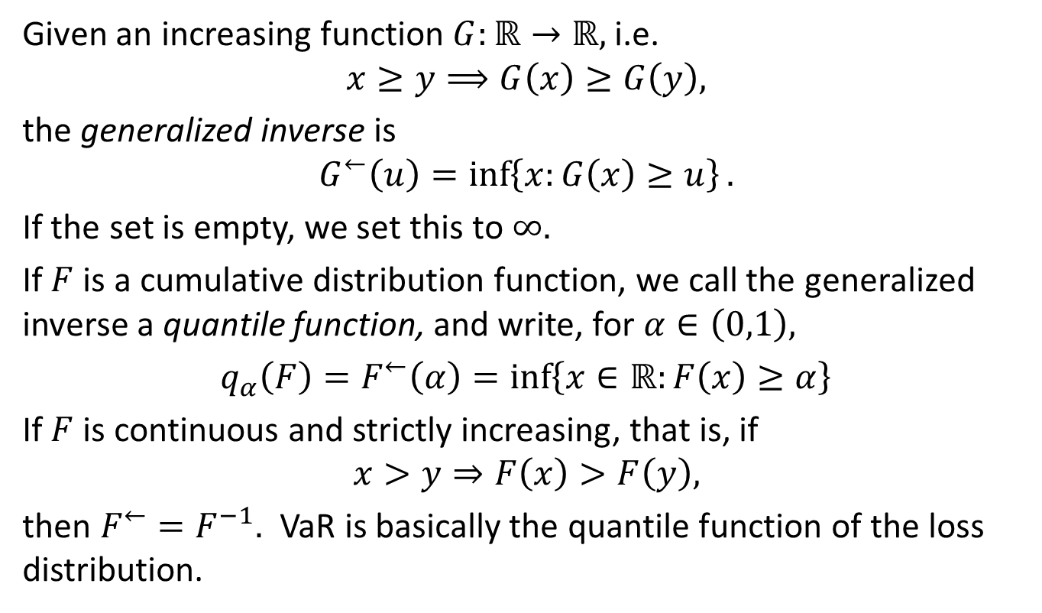
Generalized Inverse and Quantile Function
Given an increasing function $G:ℝ→ℝ,$i.e.
$$x≥y⟹G\left(x\right)≥G\left(y\right),$$
the generalized inverse is
$$G^{←}\left(u\right)=\inf\left\{x:G\left(x\right)≥u\right\}.$$
If the set is empty, we set this to $∞.$
If $F$ is a cumulative distribution function, we call the generalized inverse a quantile function, and write, for $α∈\left(0,1\right),$
$q_{α}\left(F\right)=F^{←}\left(α\right)=\inf\left\{x∈ℝ:F\left(x\right)≥α\right\}$
If $F$ is continuous and strictly increasing, that is, if
$$x>y⇒F\left(x\right)>F\left(y\right),$$
then $F^{←}=F^{−1}.$ VaR is basically the quantile function of the loss distribution.

Slide 23

An Easy but Important Lemma
$$x_{0}=q_{α}\left(F\right)⇔$$
$$F\left(x_{0}\right)≥α and F\left(x\right)<α ∀x<x_{0}$$

Slide 24
VaR Drawbacks
VaR tells you where the beginning of the tail is, and does not measure the overall tail impact on risk (Expected Shortfall, covered later, is a stronger attempt to do that).
VaR does not consider liquidity – a 1-day VaR only considers changes in mid market price, and does not consider inability to sell at that price in extreme conditions. The concept of liquidity horizon, the minimum time it takes to unwind the position and get something close to the market value, tries to address this issue. Creating risk measures that account for different liquidity horizons is a hot topic in risk which we will revisit later.
Because of illiquidity and because of model risk, it is inaccurate, strictly speaking, to think of VaR as saying that the bank will not lose “this much” tomorrow with a 99 percent probability. It will be much worse if you try to actually unload the position, and your models may be off.
Even worse, VaR does not always behave well when aggregating portfolios, meaning that the sum of VaRs for two portfolios is sometimes less than the VaR for the aggregate portfolio. Much more on this later in the course.

Slide 25
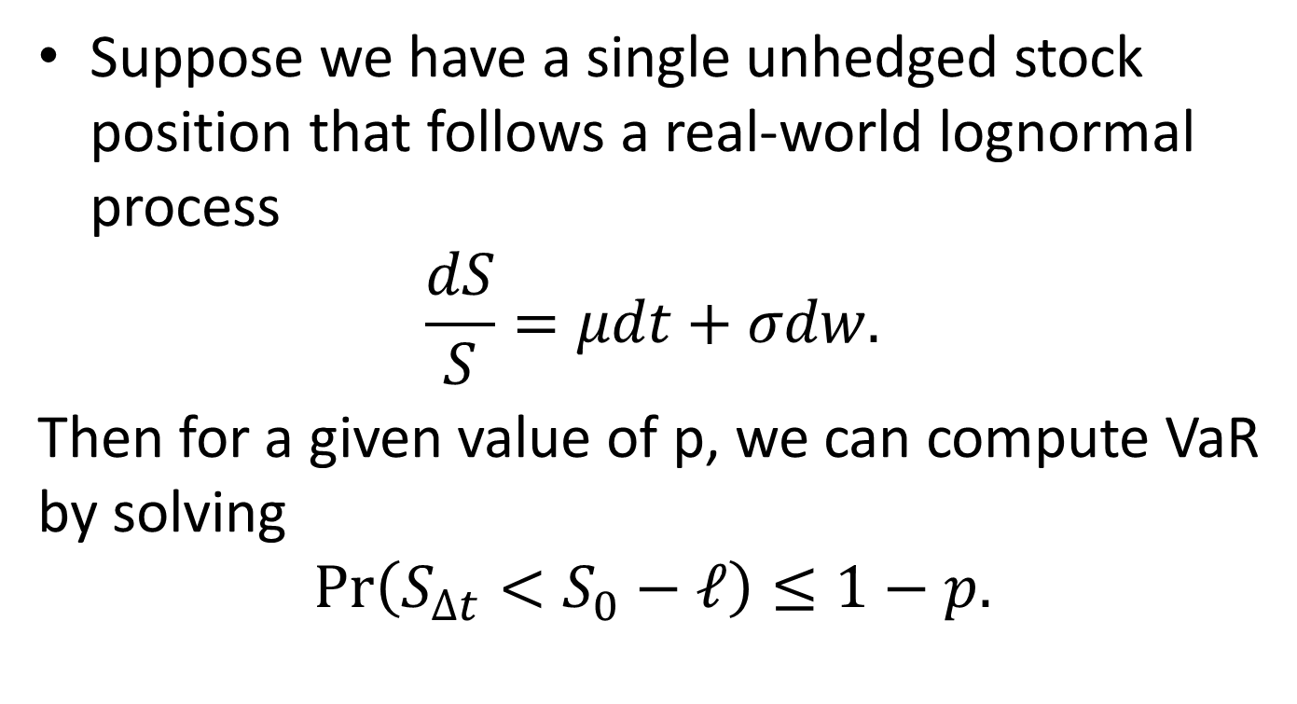
VaR Simple Example
Suppose we have a single unhedged stock position that follows a real-world lognormal process
$$\frac{dS}{S}=μdt+σdw.$$
Then for a given value of p, we can compute VaR by solving
$$\operatorname{Pr}\left(S_{∆t}<S_{0}−ℓ\right)≤1−p.$$

Slide 26
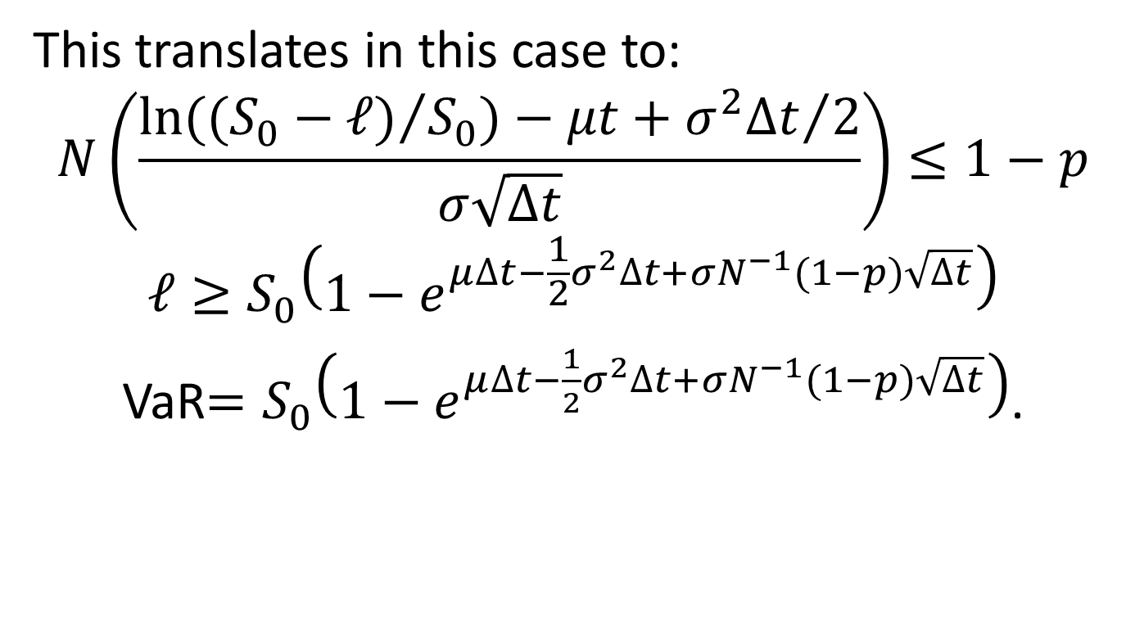
VaR Simple Example, Cont’d
This translates in this case to:
$$N\left(\frac{ln⁡({(S_{0}−ℓ)}/{S_{0})−μt+{σ^{2}∆t}/2}}{σ\sqrt{∆t}}\right)≤1−p$$
$$ℓ≥S_{0}\left(1−e^{μ∆t−\frac{1}{2}σ^{2}∆t+σN^{−1}(1−p)\sqrt{∆t}}\right)$$
VaR$=S_{0}\left(1−e^{μ∆t−\frac{1}{2}σ^{2}∆t+σN^{−1}(1−p)\sqrt{∆t}}\right)$.

Slide 27
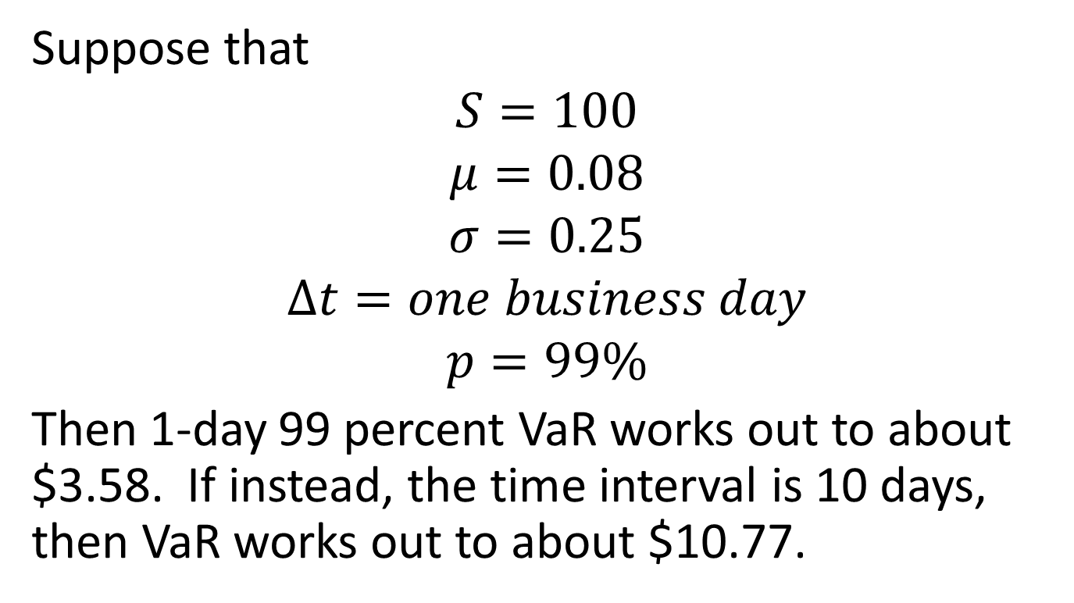
VaR Simple Example, Cont’d
Suppose that
$$S=100$$
$$μ=0.08$$
$$σ=0.25$$
$$∆t=one business day$$
$$p=99\%$$
Then 1-day 99 percent VaR works out to about $3.58. If instead, the time interval is 10 days, then VaR works out to about $10.77.

Slide 28
Another Simple VaR Example
Suppose we have a European call option on a stock or currency, and we let

Slide 29
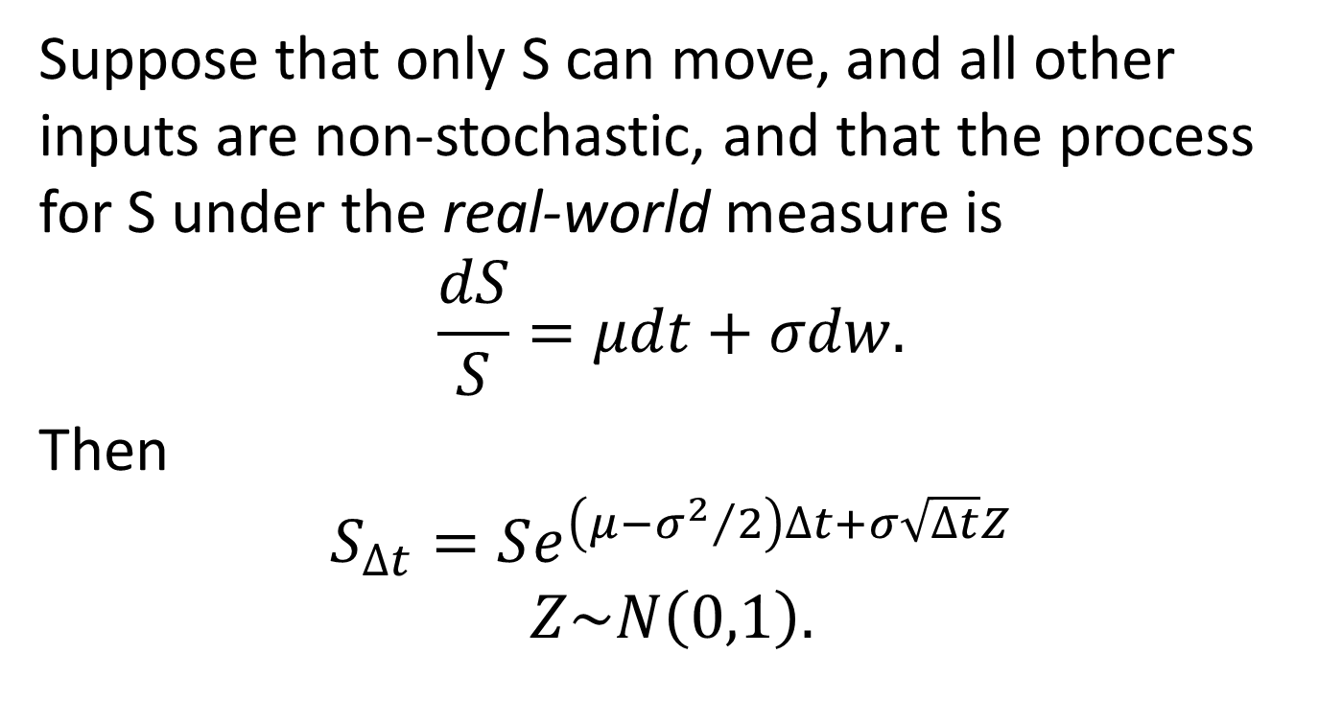
2nd Example, Cont’d
Suppose that only S can move, and all other inputs are non-stochastic, and that the process for S under the real-world measure is
$$\frac{dS}{S}=μdt+σdw.$$
Then
$$S_{∆t}=Se^{\left(μ−{σ^{2}}/2\right)∆t+σ\sqrt{∆t}Z}$$
$$Z\sim N\left(0,1\right).$$

Slide 30
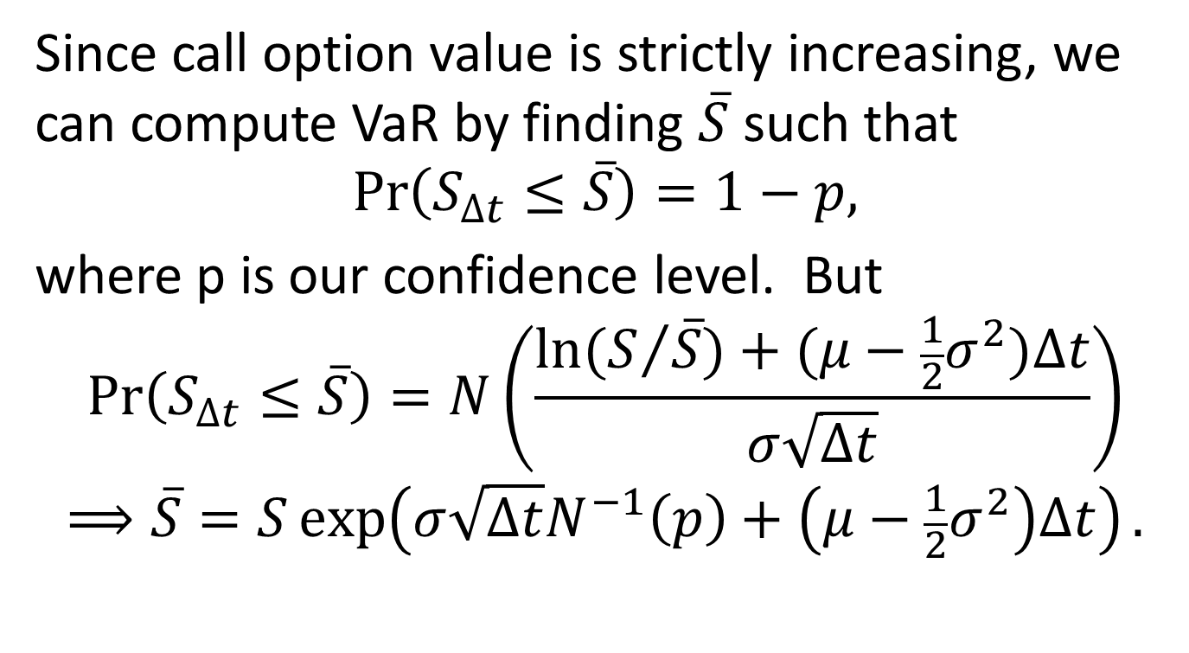
2nd Example, Cont’d
Since call option value is strictly increasing, we can compute VaR by finding $\overline{S}$ such that
$$\operatorname{Pr}\left(S_{∆t}≤\overline{S}\right)=1−p,$$
where p is our confidence level. But
$$\operatorname{Pr}\left(S_{∆t}≤\overline{S}\right)=N\left(\frac{ln⁡(S/{\overline{S})+(μ−\frac{1}{2}σ^{2})∆t}}{σ\sqrt{∆t}}\right)$$
$$⟹\overline{S}=S\exp\left(σ\sqrt{∆t}N^{−1}\left(p\right)+\left(μ−\frac{1}{2}σ^{2}\right)∆t\right).$$

Slide 31
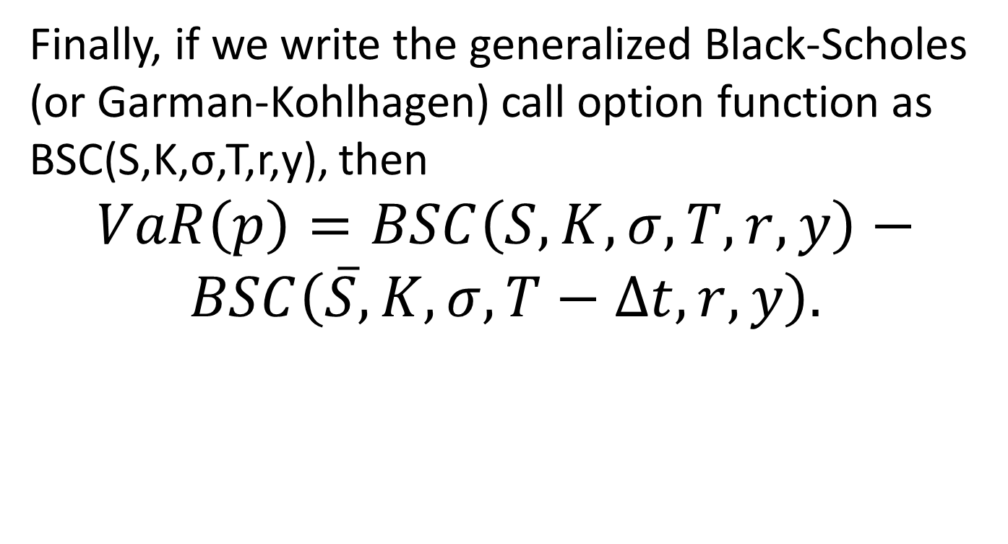
2nd Example, Conclusion
Finally, if we write the generalized Black-Scholes (or Garman-Kohlhagen) call option function as BSC(S,K,σ,T,r,y), then
$$VaR\left(p\right)=BSC\left(S,K,σ,T,r,y\right)−$$
$$BSC\left(\overline{S},K,σ,T−∆t,r,y\right).$$

Slide 32
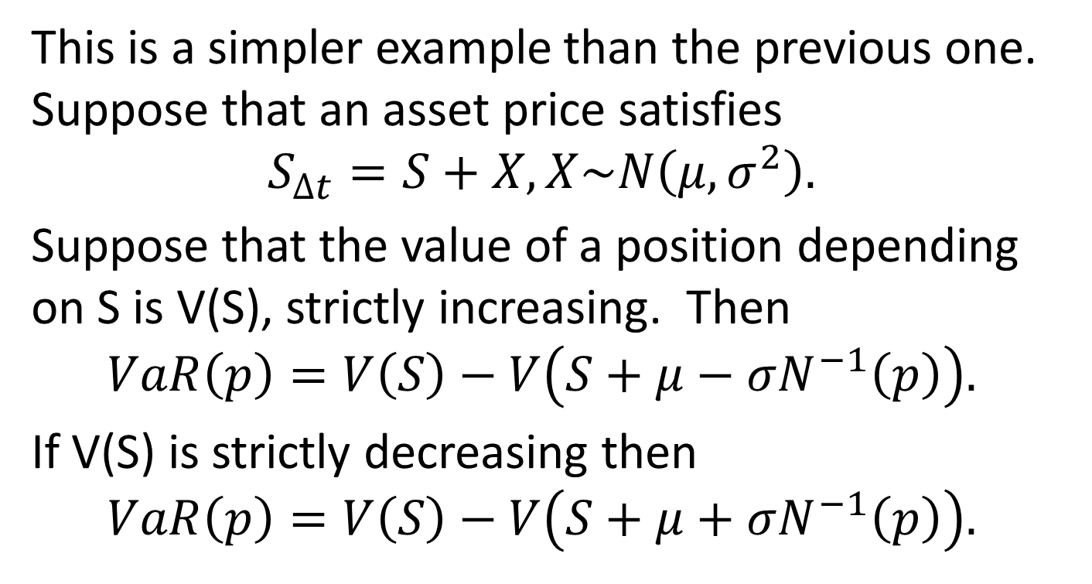
3rd Example – Normal Distribution
This is a simpler example than the previous one. Suppose that an asset price satisfies
$$S_{∆t}=S+X, X\sim N\left(μ,σ^{2}\right).$$
Suppose that the value of a position depending on S is V(S), strictly increasing. Then
$$VaR\left(p\right)=V\left(S\right)−V\left(S+μ−σN^{−1}\left(p\right)\right).$$
If V(S) is strictly decreasing then
$$VaR\left(p\right)=V\left(S\right)−V\left(S+μ+σN^{−1}\left(p\right)\right).$$

Slide 33
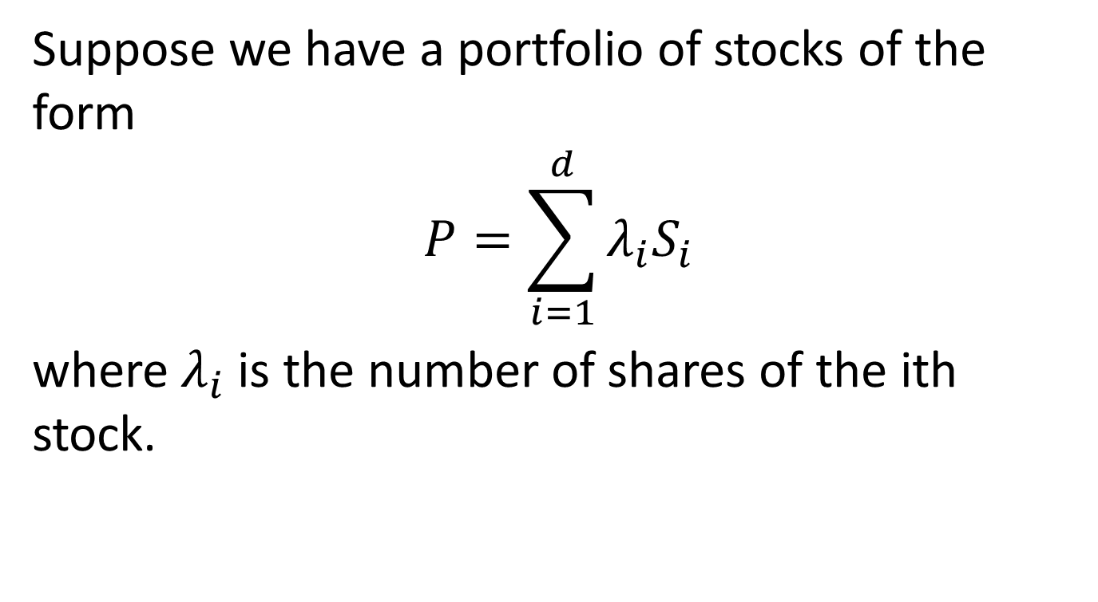
4th Example – A Portfolio of Stocks
Suppose we have a portfolio of stocks of the form
$$P=\sum_{i=1}^{d}{λ_{i}S_{i}}$$
where $λ_{i}$ is the number of shares of the ith stock.

Slide 34
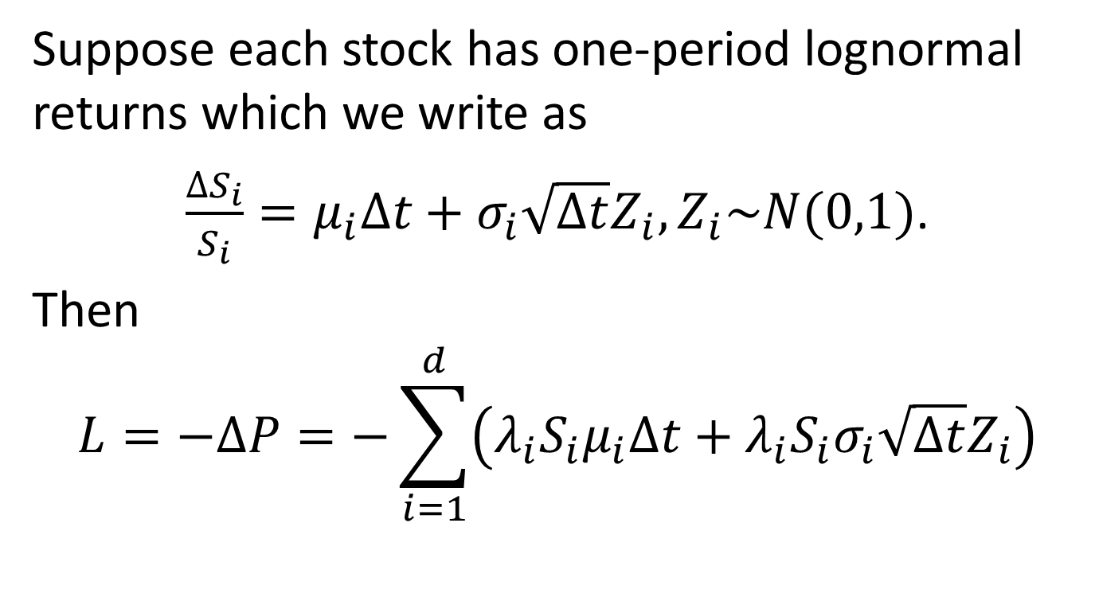
Stock Portfolio, Cont’d
Suppose each stock has one-period lognormal returns which we write as
$\frac{∆S_{i}}{S_{i}}=μ_{i}∆t+σ_{i}\sqrt{∆t}Z_{i}, Z_{i}\sim N(0,1)$.
Then
$$L=−∆P=−\sum_{i=1}^{d}{\left(λ_{i}S_{i}μ_{i}Δt+λ_{i}S_{i}σ_{i}\sqrt{Δt}Z_{i}\right)}$$

Slide 35
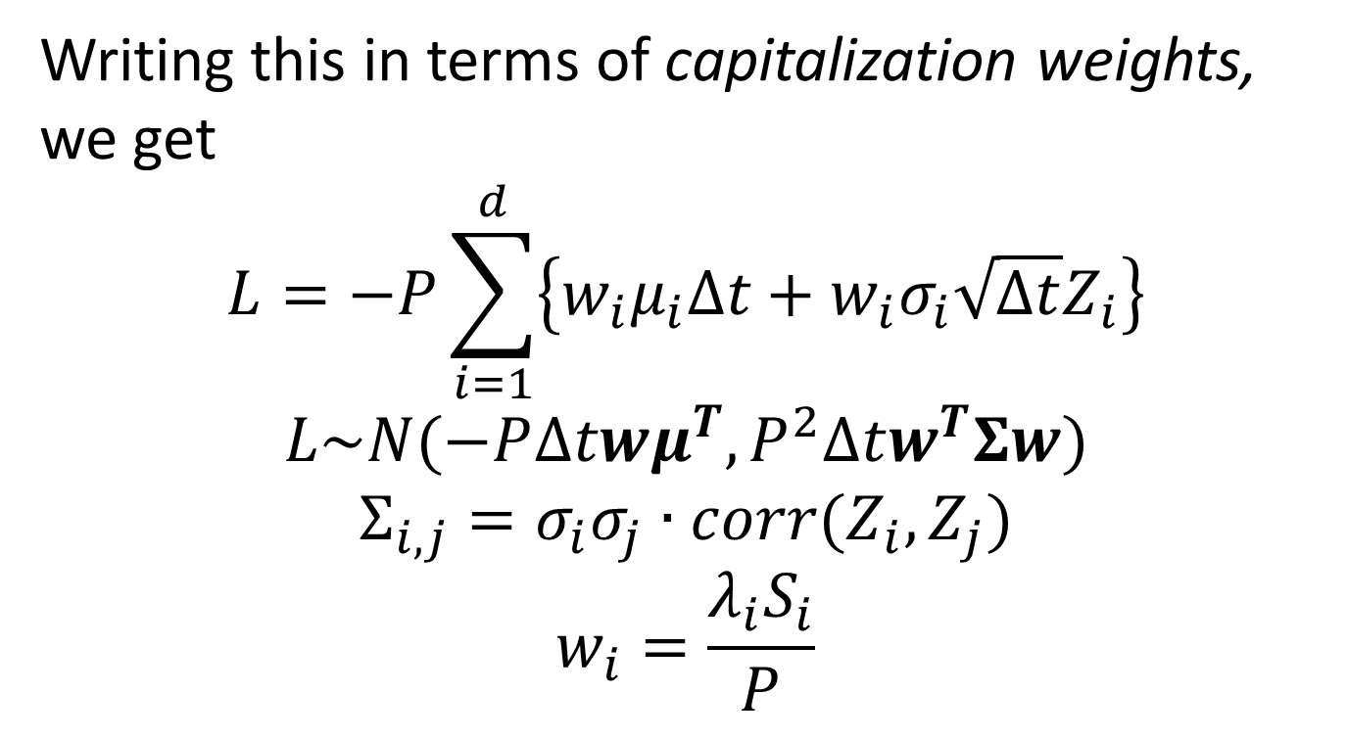
Stock Portfolio, Cont’d
Writing this in terms of capitalization weights, we get
$$L=−P\sum_{i=1}^{d}{\left\{w_{i}μ_{i}Δt+w_{i}σ_{i}\sqrt{Δt}Z_{i}\right\}}$$
$$L\sim N(−P∆twμ^{T},P^{2}∆tw^{T}Σw)$$
$$Σ_{i,j}=σ_{i}σ_{j}∙corr(Z_{i},Z_{j})$$
$$w_{i}=\frac{λ_{i}S_{i}}{P}$$

Slide 36

Stock Portfolio VaR
If we let
$$M=−PΔtμw^{T}$$
$V=P^{2}∆tw^{T}Σw$,
then
$$VaR\left(p\right)=M+\sqrt{V}N^{−1}(1−p)$$

Slide 37
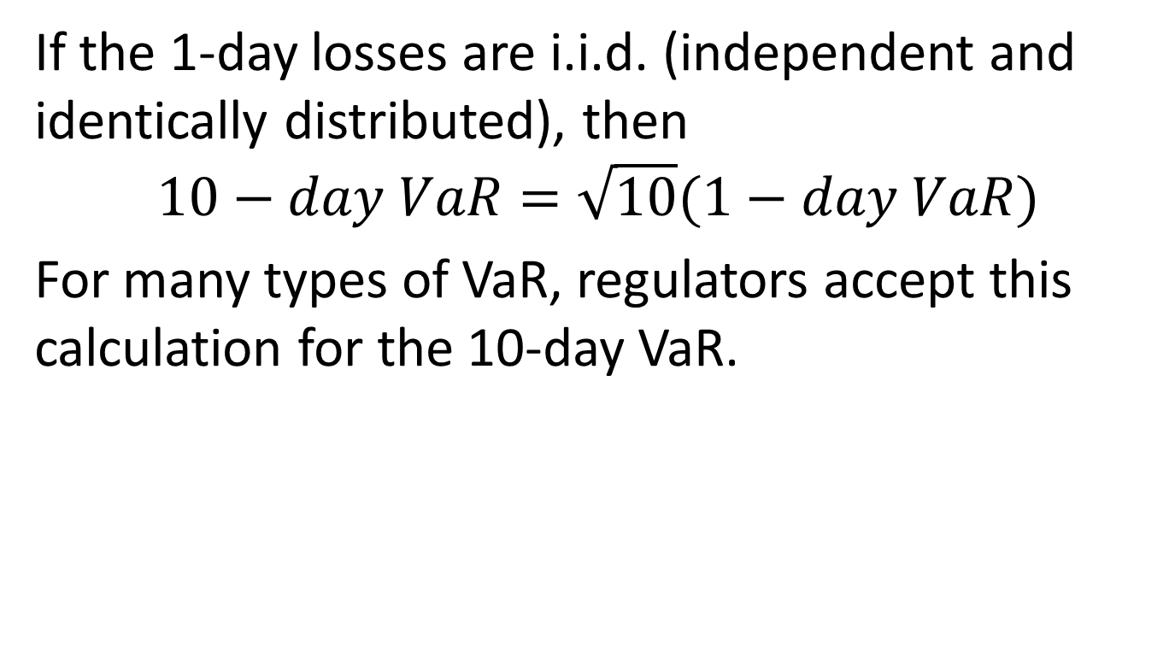
10-Day vs 1-Day Scaling
If the 1-day losses are i.i.d. (independent and identically distributed), then
$$10−day VaR=\sqrt{10}(1−day VaR)$$
For many types of VaR, regulators accept this calculation for the 10-day VaR.

Slide 38
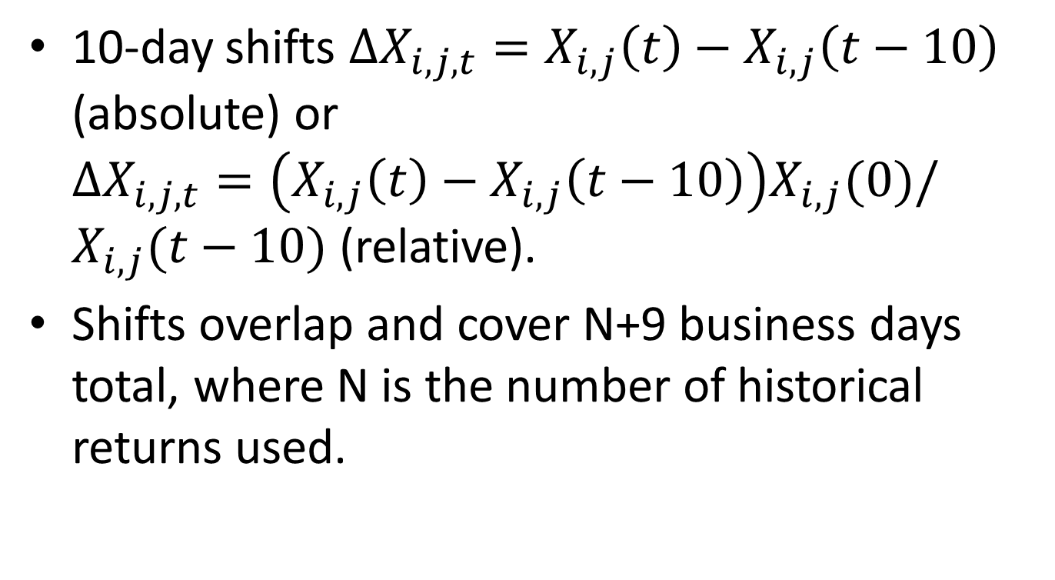
One Day versus Ten Days
10-day shifts $∆X_{i,j,t}=X_{i,j}\left(t\right)−X_{i,j}\left(t−10\right)$ (absolute) or $∆X_{i,j,t}=\left(X_{i,j}\left(t\right)−X_{i,j}\left(t−10\right)\right)X_{i,j}(0)/X_{i,j}(t−10)$ (relative).
Shifts overlap and cover N+9 business days total, where N is the number of historical returns used.

Slide 39
What is VaR Used For?
VaR is used as a tool to decide how large a trading book to have. An equities or FX desk will often have an overall VaR limit enforced by upper management. A “real-time” VaR calculation can determine whether a trade is permissible.
VaR is used at the firm level to determine the amount of capital the Feds will require the firm to have. VaR capital is combined with capital requirements from Specific Risk, Stress Scenarios and other risk measures mentioned here.

Slide 40
Basic Calculation Methods
Analytical Formulas or approximations – rarely possible unless the underlying pricing models are extremely simple.
Historical Simulation – last N 1 or 10-day interval market changes are applied to current conditions, and we take the loss corresponding to the 99th percentile. The Feds allow N as low as 251 (one year), with the second worst loss chosen as the VaR.
Monte Carlo Model – Create a parametric model for the next period’s moves based on current pricing models and sufficient historical data, simulate N times, take least of worst 1% of losses.

Slide 41
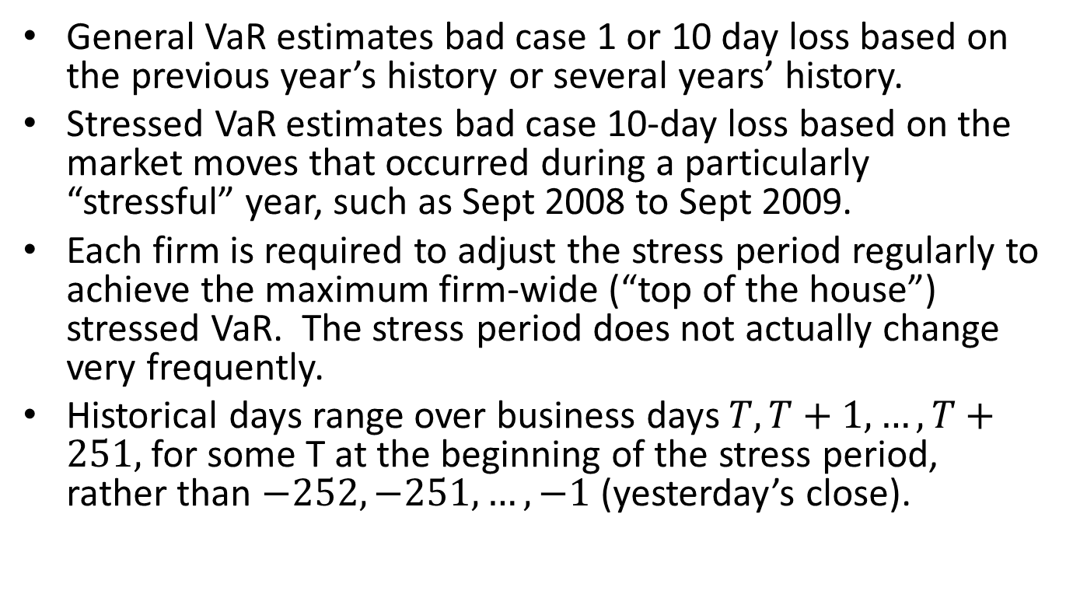
General vs Stressed VaR
General VaR estimates bad case 1 or 10 day loss based on the previous year’s history or several years’ history.
Stressed VaR estimates bad case 10-day loss based on the market moves that occurred during a particularly “stressful” year, such as Sept 2008 to Sept 2009.
Each firm is required to adjust the stress period regularly to achieve the maximum firm-wide (“top of the house”) stressed VaR. The stress period does not actually change very frequently.
Historical days range over business days $T,T+1,…,T+251,$ for some T at the beginning of the stress period, rather than $−252,−251,…,−1$(yesterday’s close).

Slide 42
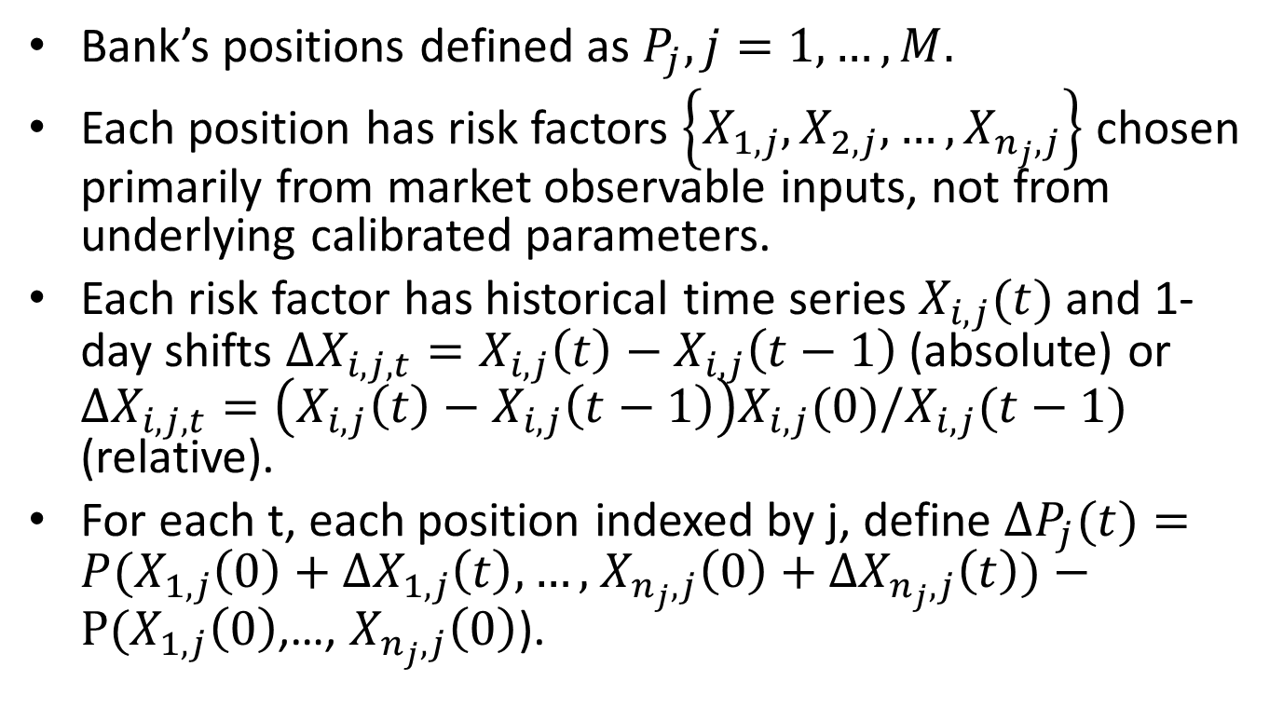
Historical General VaR, More Detail
Bank’s positions defined as $P_{j},j=1,…,M.$
Each position has risk factors $\left\{X_{1,j},X_{2,j},…,X_{n_{j},j}\right\}$ chosen primarily from market observable inputs, not from underlying calibrated parameters.
Each risk factor has historical time series $X_{i,j}(t)$ and 1-day shifts $∆X_{i,j,t}=X_{i,j}\left(t\right)−X_{i,j}\left(t−1\right)$ (absolute) or $∆X_{i,j,t}=\left(X_{i,j}\left(t\right)−X_{i,j}\left(t−1\right)\right)X_{i,j}(0)/X_{i,j}(t−1)$ (relative).
For each t, each position indexed by j, define $∆P_{j}(t)=P(X_{1,j}\left(0\right)+∆X_{1,j}\left(t\right),…,$ $X_{n_{j},j}\left(0\right)+∆X_{n_{j},j}\left(t\right))−P(X_{1,j}\left(0\right)$,…, $X_{n_{j},j}\left(0\right)$).

Slide 43
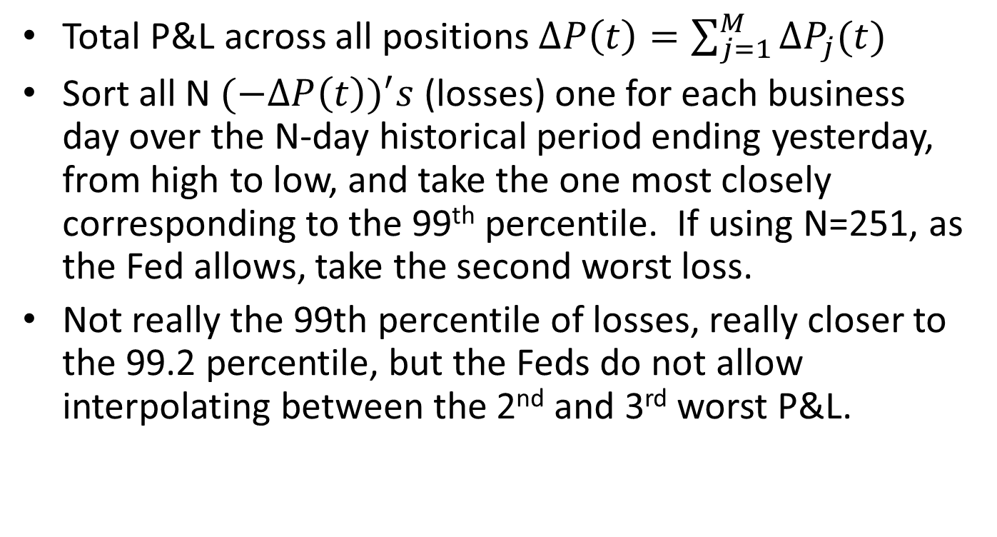
Historical General VaR, cont’d
Total P&L across all positions $∆P\left(t\right)=\sum_{j=1}^{M}{∆P_{j}(t)}$
Sort all N $(−∆P{\left(t\right))}^{′}s$ (losses) one for each business day over the N-day historical period ending yesterday, from high to low, and take the one most closely corresponding to the 99th percentile. If using N=251, as the Fed allows, take the second worst loss.
Not really the 99th percentile of losses, really closer to the 99.2 percentile, but the Feds do not allow interpolating between the 2nd and 3rd worst P&L.

Slide 44
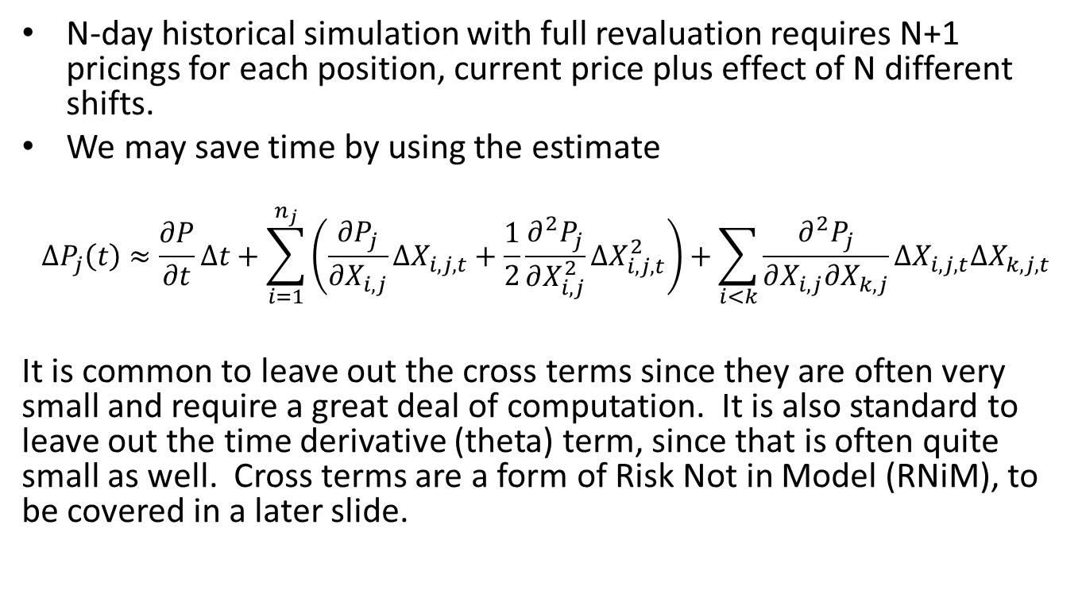
Delta/Gamma Approximation
N-day historical simulation with full revaluation requires N+1 pricings for each position, current price plus effect of N different shifts.
We may save time by using the estimate
$$∆P_{j}\left(t\right)≈\frac{∂P}{∂t}Δt+\sum_{i=1}^{n_{j}}{\left(\frac{∂P_{j}}{∂X_{i,j}}∆X_{i,j,t}+\frac{1}{2}\frac{∂^{2}P_{j}}{∂X_{i,j}^{2}}∆X_{i,j,t}^{2}\right)+\sum_{i<k}{\frac{∂^{2}P_{j}}{∂X_{i,j}∂X_{k,j}}∆X_{i,j,t}∆X_{k,j,t}}}$$
It is common to leave out the cross terms since they are often very small and require a great deal of computation. It is also standard to leave out the time derivative (theta) term, since that is often quite small as well. Cross terms are a form of Risk Not in Model (RNiM), to be covered in a later slide.

Slide 45
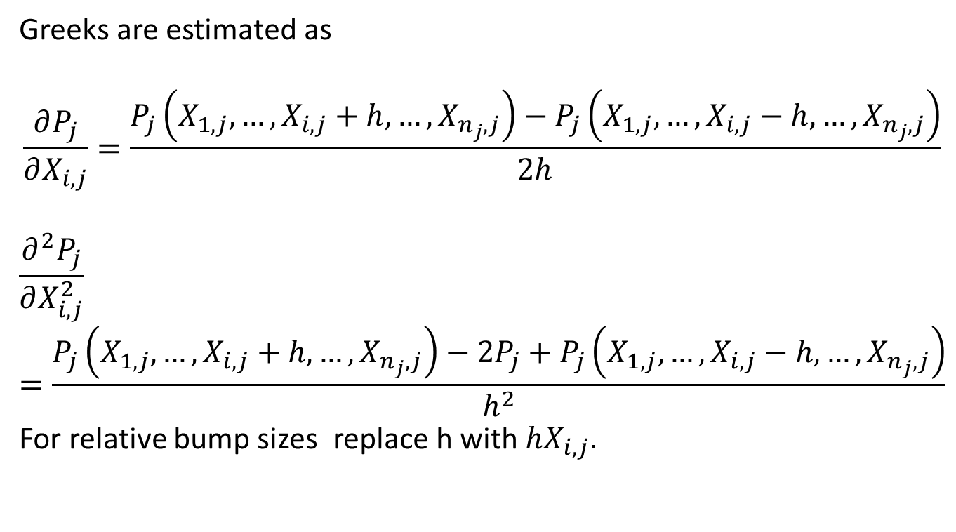
Delta/Gamma Cont’d
Greeks are estimated as
$$\frac{∂P_{j}}{∂X_{i,j}}=\frac{P_{j}\left(X_{1,j},…,X_{i,j}+h,…,X_{n_{j},j}\right)−P_{j}\left(X_{1,j},…,X_{i,j}−h,…,X_{n_{j},j}\right)}{2h}$$
$$\frac{∂^{2}P_{j}}{∂X_{i,j}^{2}}=\frac{P_{j}\left(X_{1,j},…,X_{i,j}+h,…,X_{n_{j},j}\right)−2P_{j}+P_{j}\left(X_{1,j},…,X_{i,j}−h,…,X_{n_{j},j}\right)}{h^{2}}$$
For relative bump sizes replace h with $hX_{i,j}.$

Slide 46
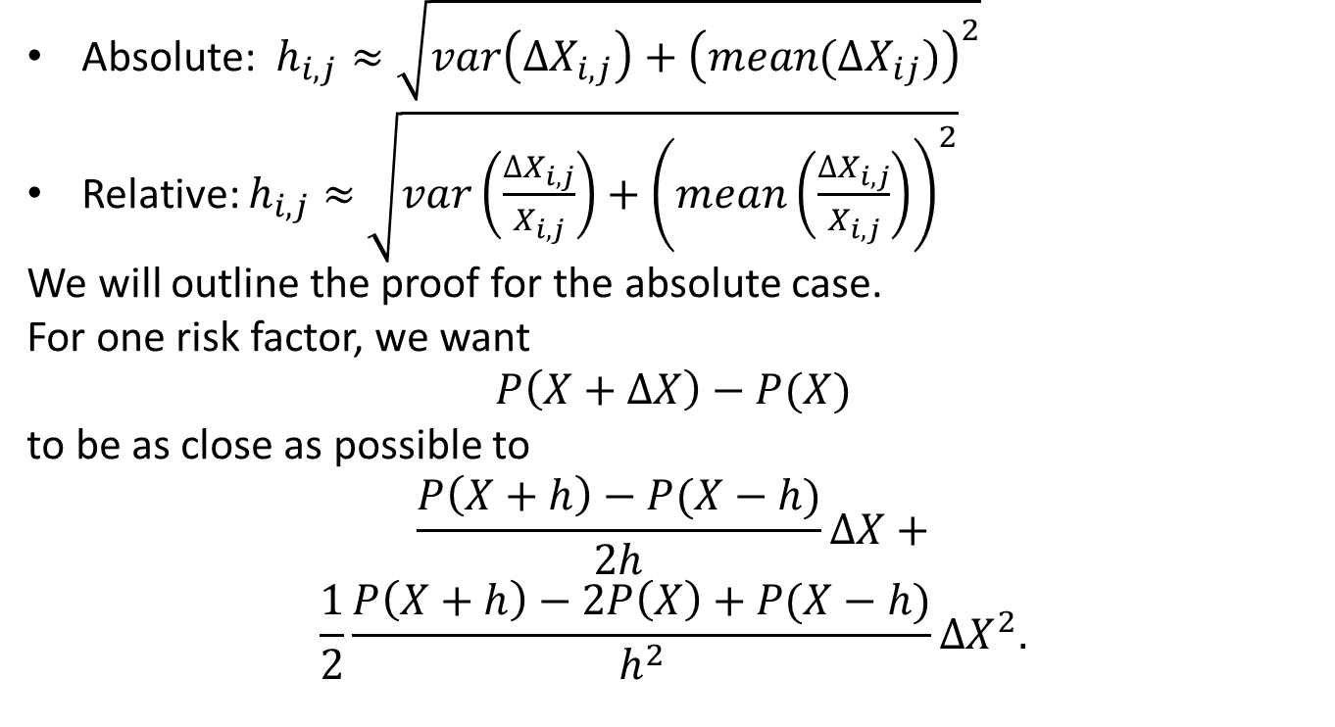
Most Accurate Bump Sizes
Absolute: $h_{i,j}≈\sqrt{var\left(∆X_{i,j}\right)+{\left(mean(∆X_{ij})\right)}^{2}}$
Relative: $h_{i,j}≈$ $\sqrt{var\left(\frac{∆X_{i,j}}{X_{i,j}}\right)+{\left(mean\left(\frac{∆X_{i,j}}{X_{i,j}}\right)\right)}^{2}}$
We will outline the proof for the absolute case.
For one risk factor, we want
$$P\left(X+∆X\right)−P(X)$$
to be as close as possible to
$$\frac{P\left(X+h\right)−P(X−h)}{2h}∆X+$$
$$\frac{1}{2}\frac{P\left(X+h\right)−2P\left(X\right)+P(X−h)}{h^{2}}∆X^{2}.$$

Slide 47
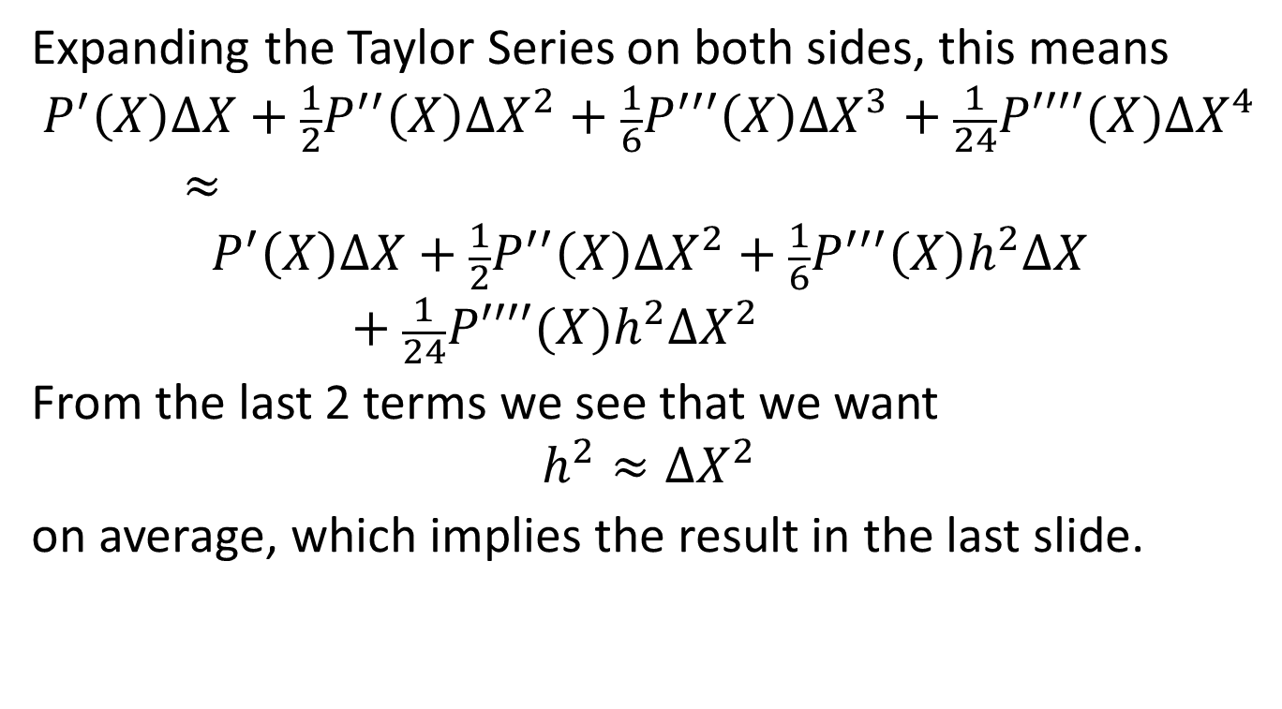
Most Accurate Bump Sizes, Cont’d
Expanding the Taylor Series on both sides, this means
$$P^{′}\left(X\right)∆X+\frac{1}{2}P^{′′}\left(X\right)∆X^{2}+\frac{1}{6}P^{′′′}\left(X\right)∆X^{3}+\frac{1}{24}P′′′′(X)∆X^{4}≈$$
$$P^{′}\left(X\right)∆X+\frac{1}{2}P^{′′}\left(X\right)∆X^{2}+\frac{1}{6}P^{′′′}\left(X\right)h^{2}∆X+\frac{1}{24}P′′′′(X)h^{2}∆X^{2}$$
From the last 2 terms we see that we want
$$h^{2}≈∆X^{2}$$
on average, which implies the result in the last slide.

Slide 48
Calibrated Parameters vs Risk Drivers
The risk drivers for VaR, the X’s, are typically market inputs, e.g. spot, ATM volatility, some sort of volatility skew measure, and interest rates, rather than underlying model parameters.
Full revaluation would require re-calibration for every historical shift of the inputs.
Delta Gamma approximation requires inverting a Jacobian matrix (example next slide)

Slide 49
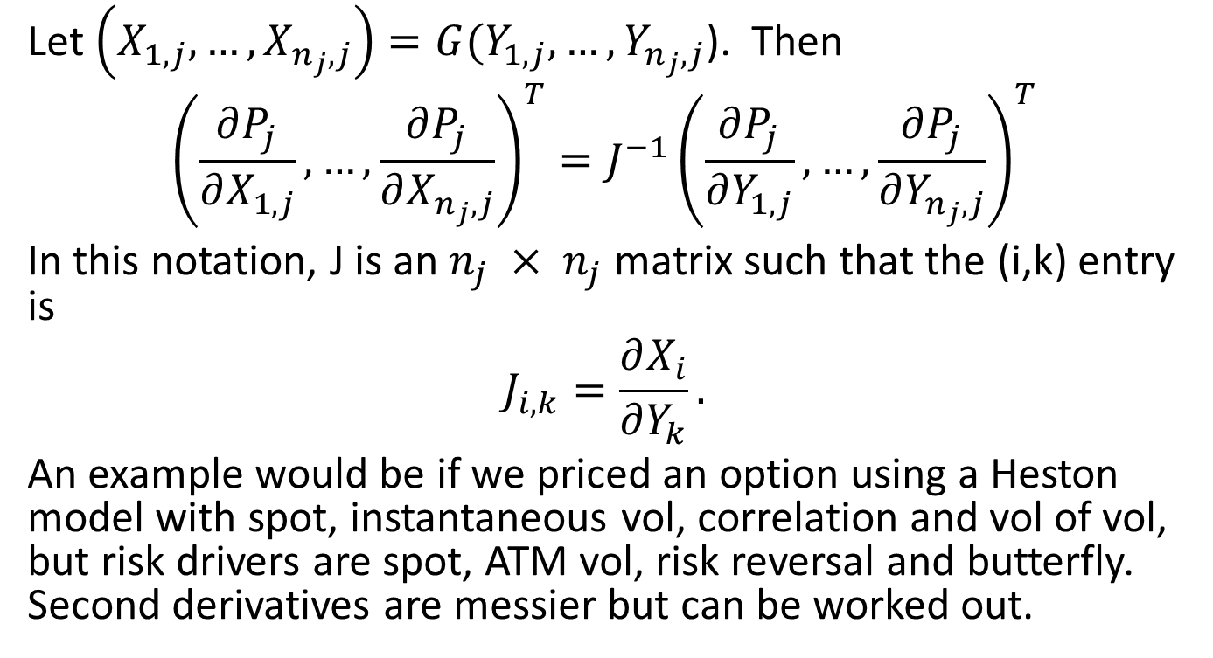
Calibrated Parameters vs Risk Drivers
Let $\left(X_{1,j},…,X_{n_{j},j}\right)=G(Y_{1,j},…,Y_{n_{j},j}$). Then
$${\left(\frac{∂P_{j}}{∂X_{1,j}},…,\frac{∂P_{j}}{∂X_{n_{j},j}}\right)}^{T}=J^{−1}{\left(\frac{∂P_{j}}{∂Y_{1,j}},…,\frac{∂P_{j}}{∂Y_{n_{j},j}}\right)}^{T}$$
In this notation, J is an $n_{j} × n_{j}$ matrix such that the (i,k) entry is
$$J_{i,k}=\frac{∂X_{i}}{∂Y_{k}}.$$
An example would be if we priced an option using a Heston model with spot, instantaneous vol, correlation and vol of vol, but risk drivers are spot, ATM vol, risk reversal and butterfly. Second derivatives are messier but can be worked out.

Slide 50
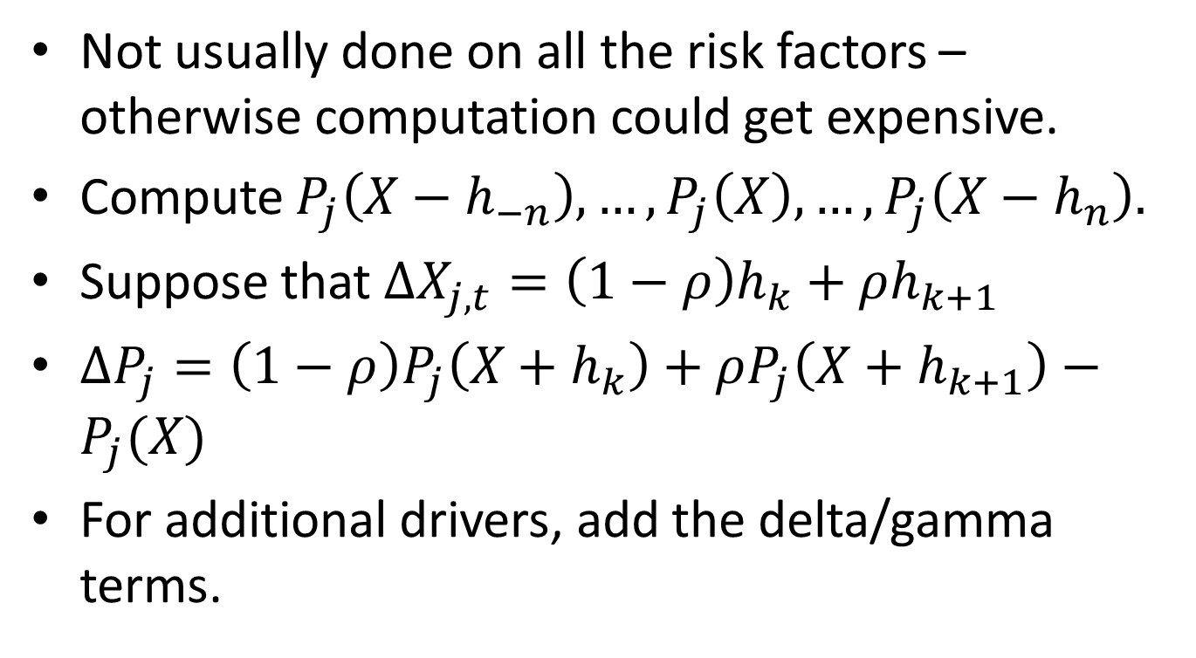
Grid Approximation
Not usually done on all the risk factors – otherwise computation could get expensive.
Compute $P_{j}\left(X−h_{−n}\right),…,P_{j}\left(X\right),…,P_{j}\left(X−h_{n}\right).$
Suppose that $∆X_{j,t}=\left(1−ρ\right)h_{k}+ρh_{k+1}$
$∆P_{j}=\left(1−ρ\right)P_{j}\left(X+h_{k}\right)+ρP_{j}\left(X+h_{k+1}\right)−P_{j}(X)$
For additional drivers, add the delta/gamma terms.

Slide 51
Expected Shortfall
VaR takes the kth worst loss of N P&Ls for the total position, corresponding to the 99th percentile.
Expected shortfall computes the average of a somewhat larger m worst P&Ls for the total position, where m corresponds to a lower percentile (Feds are proposing 97.5).
Some banks use this in lieu of or in addition to VaR because it appears to be more stable.
Regulators will eventually require it, as part of the Basel IV rules.
However, ES is tougher to backtest than VaR (next slide).

Slide 52
Backtesting a VaR Model
Backtesting involves comparing actual daily “clean” P&L (for an existing book of trades, not including new transactions) of a portfolio (or entire bank) with the previous day’s 1-day VaR calculation. When the loss on a particular day exceeds the VaR, we call that an exception. For confidence level p, the number of exceptions in a year should be around 251(1-p), or around 2-3 per year if p is 99 percent. Too many exceptions, and your VaR model is not adequately capturing the risk, and too few means that you are being too conservative (the Fed or OCC does not care if we are too conservative!). We make this more rigorous in the next slide.

Slide 53
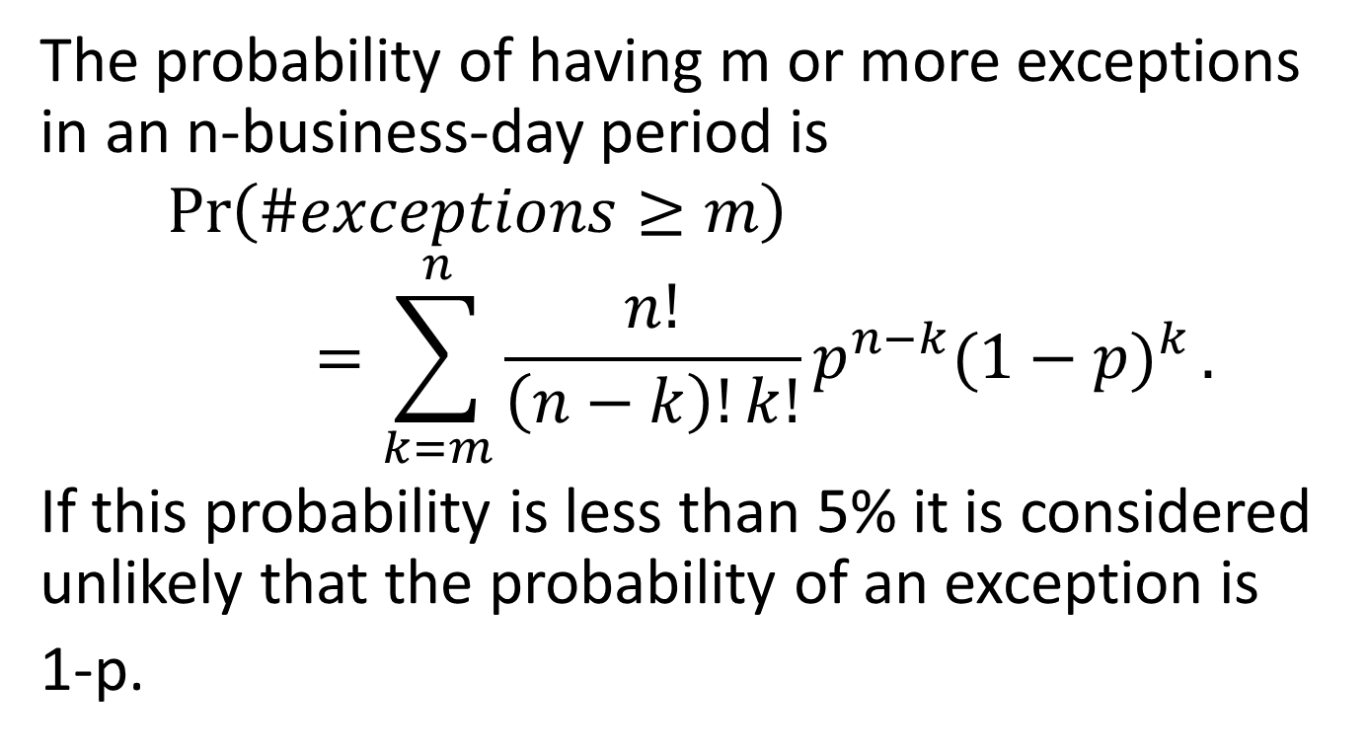
How Good is Your VaR?
The probability of having m or more exceptions in an n-business-day period is
$$\operatorname{Pr}\left(\#exceptions≥m\right)=\sum_{k=m}^{n}{\frac{n!}{\left(n−k\right)!k!}p^{n−k}{(1−p)}^{k}}.$$
If this probability is less than 5% it is considered unlikely that the probability of an exception is
1-p.

Slide 54
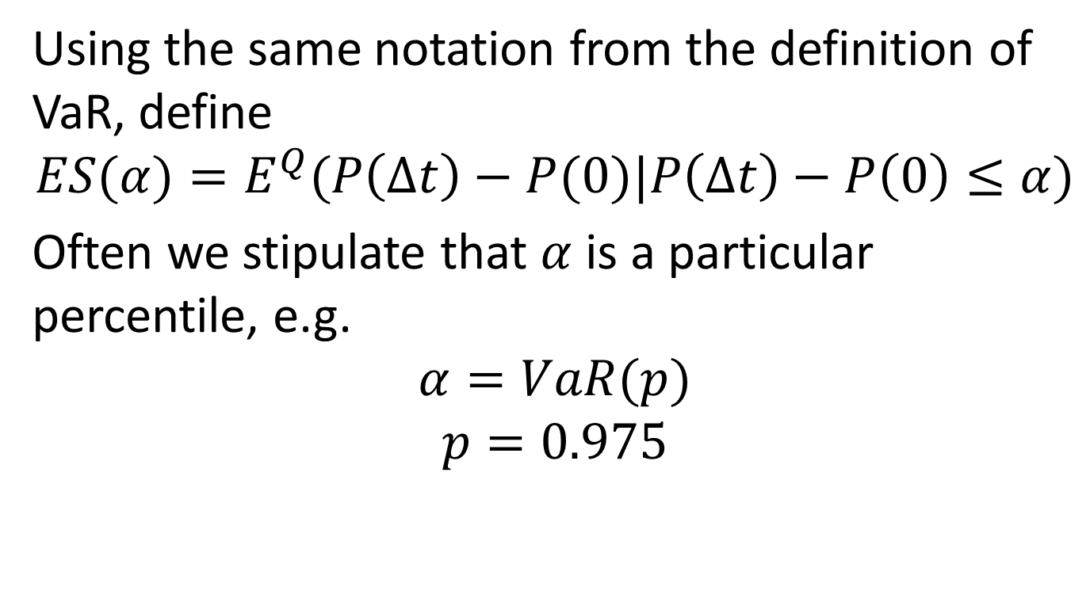
Expected Shortfall, Definition
Using the same notation from the definition of VaR, define
$$ES(α)=E^{Q}(P\left(∆t\right)−P(0)|P\left(∆t\right)−P\left(0\right)≤α)$$
Often we stipulate that $α$ is a particular percentile, e.g.
$$α=VaR(p)$$
$$p=0.975$$

Slide 55
Common risk drivers
Equities – stock price, discount rate, ATM volatilities by tenor, volatility skew and convexity.
FX – spot, ATM volatility, foreign and domestic rates, risk-reversals and butterflies
Commodities – spot, ATM volatility, various measures of skew
Interest Rates – Discount rates, forward swap rates, ATM volatilities, volatility skew for each expiry and tenor.

Slide 56
Monte Carlo Method
In this case we postulate a stochastic process for the inputs to the price of the position.
May be similar in structure to front office pricing model, except that the model for the returns must reflect past history rather than strictly calibrate to market data. VaR always uses real-world, not risk-neutral measure, even though the front office pricing routines use the risk-neutral measure.
Instead of N historical-based P&Ls for each position, we can simulate 5000, or 50000 or more scenarios.
VaR is set to 1st percentile, i.e. 500th worst out of 50000.

Slide 57
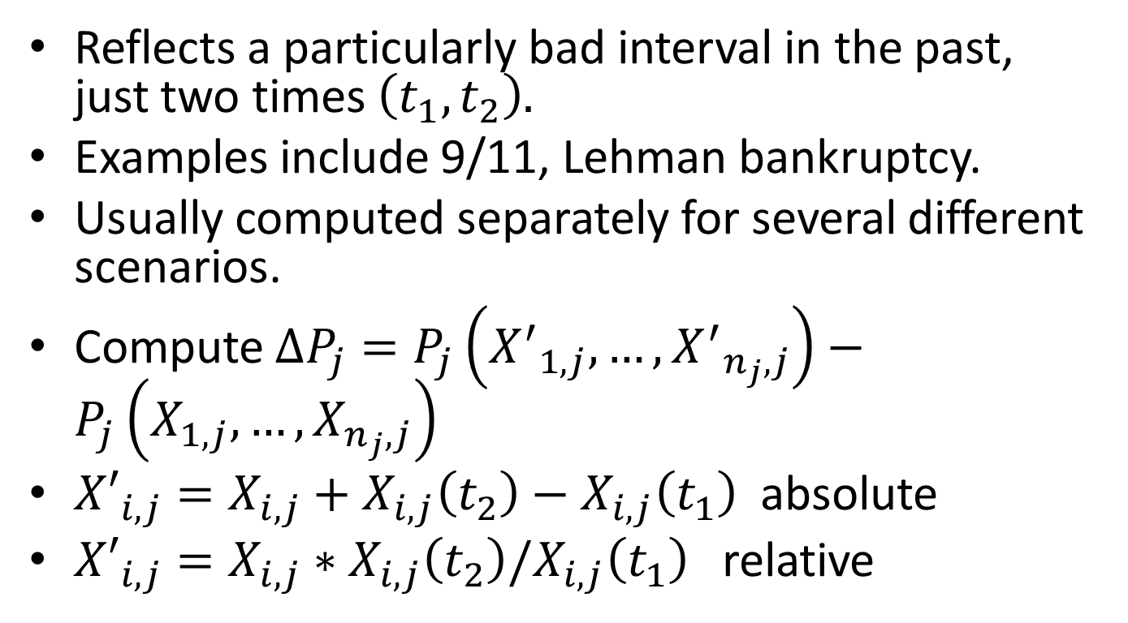
Stress Scenarios
Reflects a particularly bad interval in the past, just two times $\left(t_{1},t_{2}\right).$
Examples include 9/11, Lehman bankruptcy.
Usually computed separately for several different scenarios.
Compute $∆P_{j}=P_{j}\left({X^{′}}_{1,j},…,{X^{′}}_{n_{j},j}\right)−P_{j}\left(X_{1,j},…,X_{n_{j},j}\right)$
${X′}_{i,j}=X_{i,j}+X_{i,j}\left(t_{2}\right)−X_{i,j}\left(t_{1}\right)$ absolute
${X′}_{i,j}=X_{i,j}∗X_{i,j}\left(t_{2}\right)/X_{i,j}\left(t_{1}\right)$ relative

Slide 58
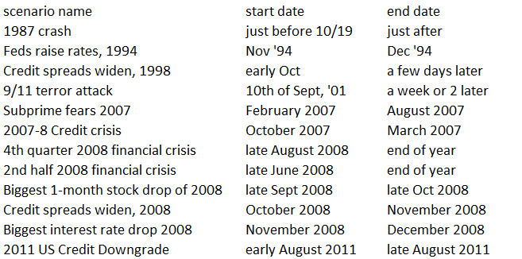
Examples of Stress Scenarios

Slide 59
Risk not in Model (RNiM)
Models for exotics usually depend on trader-marked parameters which are estimated and don’t change frequently
Examples include correlation or correlation skew for basket options, mean-reversion in commodity markets, and correlation between spot and volatility
Cross terms in delta-gamma approximation

Slide 60
RNiM, continued
Situations where shifting one driver causes another to move (extra terms in the chain rule, double-counting).
Mismatch between driver sensitivity and actual historical time series.
The regulators require us to keep track of sources of Risk Not in Model.

Slide 61
Specific Risk (SR)
Specific risk “picks up where VaR leaves off”, meaning that it attempts to capture rare events or idiosyncratic risk not covered by VaR.
Examples include huge moves in bond price, stock price or volatility caused by credit migrations, scandals, wars, drug non-approvals, etc.
Specific risk is made up of Debt Specific Risk (DSR) and Equity Specific Risk (ESR)

Slide 62
Debt Specific Risk
VaR for sovereign, agency, municipal or corporate bonds and credit default swaps captures the risk from moves in the generic credit spread for that instrument’s rating.
DSR attempts to capture risk from the “idiosyncratic” part of the credit spread, i.e. the difference between the credit spread for that CDS (or bond) and the contribution from the generic spread from that instrument’s rating.

Slide 63
Equity Specific Risk (ESR)
ESR attempts to capture events that may occur over a 10-year period, rather than a 1-year period.
For each name, compute the 1-year historical vol and 10 year kurtosis.
Create a random variable with that volatility and kurtosis
Use principal component analysis to correlate all the different names’ random variables.
Simulate N (very large number) times for each name, and zero out P&L contributions less than k standard deviations from the mean, where k roughly corresponds to the cutoff point for general VaR
Add all the P&Ls over all the positions, sort and take Number (N/100) as the specific risk.

Slide 64
ESR Shortcomings
Difficult to determine the best threshold for defining “event” risk (one might use around 2.6 standard deviations since that corresponds to a 1% tail for normals, but this is hard to calculate in general).
Returns and changes in implied volatility follow a distribution which has kurtosis, but not skew. Difficult to allow for skew in this general Monte Carlo framework (but we will try hard in the next lecture!)

Slide 65
Incremental Risk Charge (IRC)
Aims to capture impact on the credit book (bonds and CDSs) from migrations and defaults, which are not included in VaR or DSR.
Create up to 3 N(0,1) random variables based on market, regional and sector returns.
Use these to create N(0,1) random variables for each name, with the desired correlation matrix.
Default or migration for each name can occur in 1 year if the variable breaches any of a set of thresholds.

Slide 66
IRC, continued
Recovery is a function of each name’s random variable
Each simulation is a single 1-year drawing for the underlying variables
For each position, compute a P&L only if a migration or default occurs (most are 0).
Add up total P&L, sort, and choose number N/1000 out of N simulations (99.9% confidence level, rather than 99%)
We will cover IRC in more detail in a later lecture on credit risk

Slide 67
Economic Capital Model
Basel II also requires banks to have an internal model which measures the amount of capital (assets minus liabilities) they need to avoid insolvency in one year.
Since many banks are rated AA, and the rate of default is around 0.03% per year, that means computing a worst-case 1-year loss at a 99.97% confidence level.

Slide 68
Economic Capital, Continued
Economic Capital may incorporate several different kinds of risk including
Market Risk
Credit Risk
(Possibly) Operational Risk

Slide 69
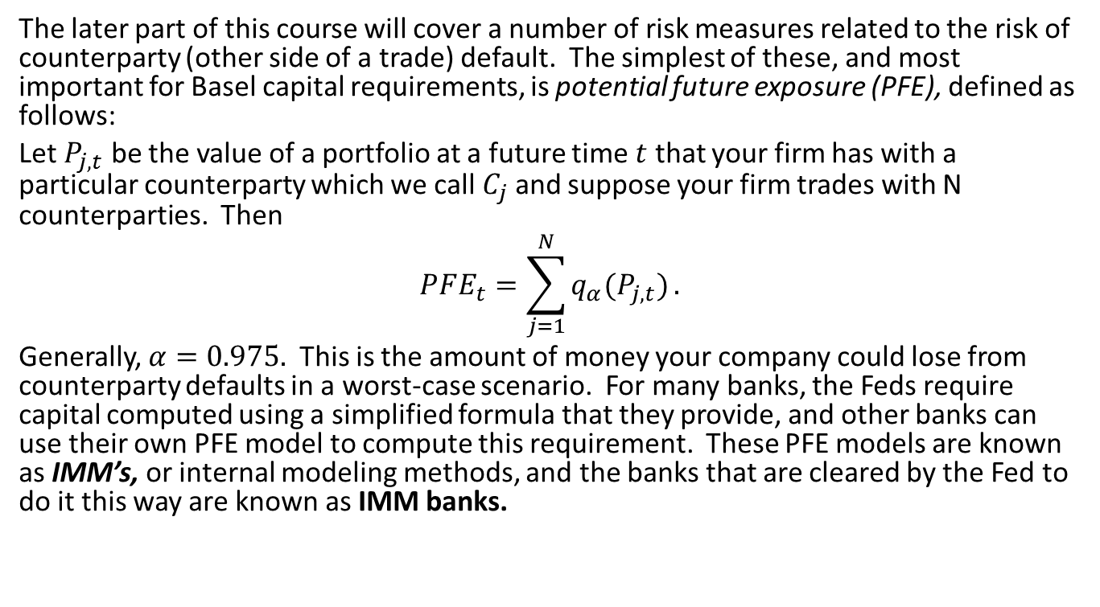
Finally, There’s Counterparty Risk
The later part of this course will cover a number of risk measures related to the risk of counterparty (other side of a trade) default. The simplest of these, and most important for Basel capital requirements, is potential future exposure (PFE), defined as follows:
Let $P_{j,t}$ be the value of a portfolio at a future time $t$ that your firm has with a particular counterparty which we call $C_{j}$ and suppose your firm trades with N counterparties. Then
$$PFE_{t}=\sum_{j=1}^{N}{q_{α}(P_{j,t})}.$$
Generally, $α=0.975.$ This is the amount of money your company could lose from counterparty defaults in a worst-case scenario. For many banks, the Feds require capital computed using a simplified formula that they provide, and other banks can use their own PFE model to compute this requirement. These PFE models are known as IMM’s, or internal modeling methods, and the banks that are cleared by the Fed to do it this way are known as IMM banks.

Slide 70
Upcoming Topics and Reading
Next lecture will begin covering Monte Carlo methods and unconditional multivariate models, which are the focus of Chapter 6 of McNeil, Frey and Embrechts (known from now on as MFE). Topics will include
Simulating Monte Carlo models
Multivariate normal distribution
Multivariate t distribution
Normal mixtures and mean-variance mixtures
Hyperbolic distributions
Spherical and Elliptical distributions
Factor models and principal component analysis

